Slide 1
Opportunistic Scheduling Via IRS Assisted Communication
Guna Sai Kiran Nekkanti

Slide 2
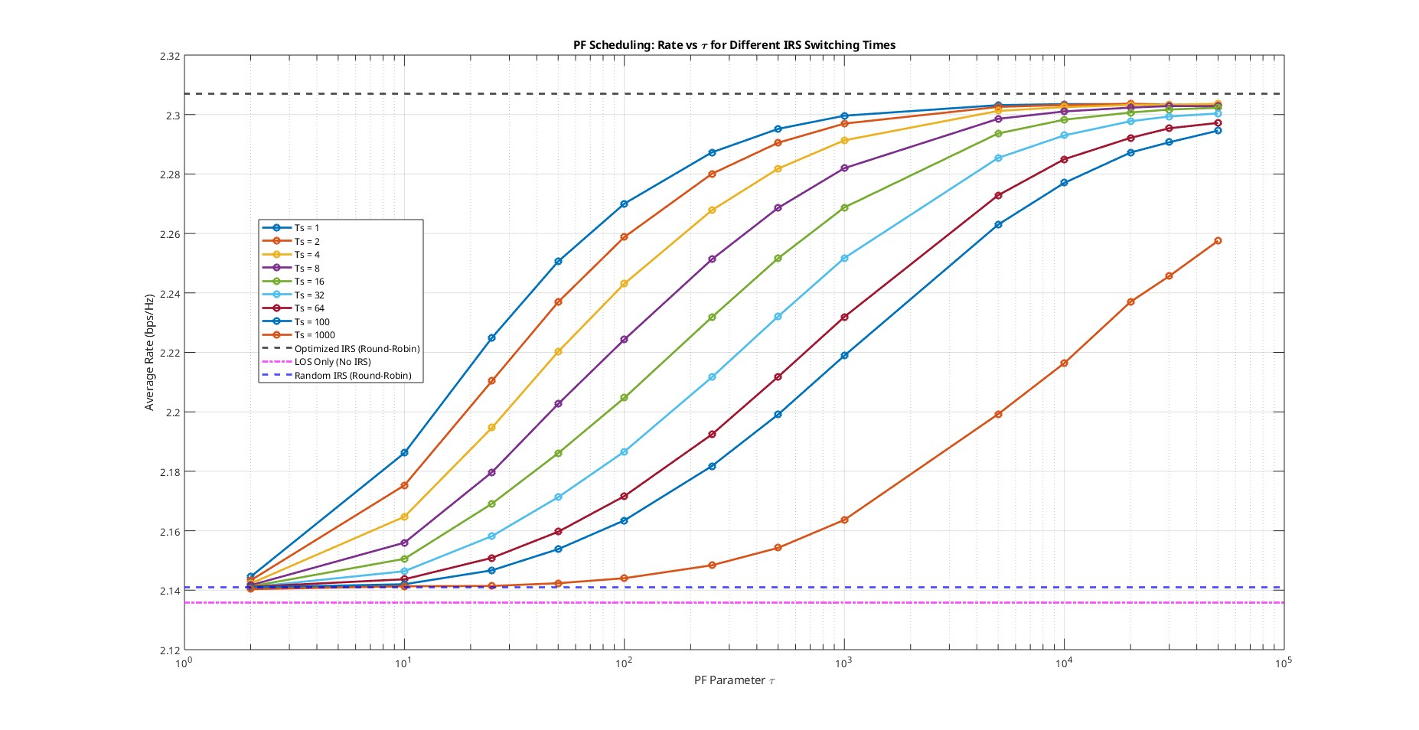
K = 25
N =16

Slide 3
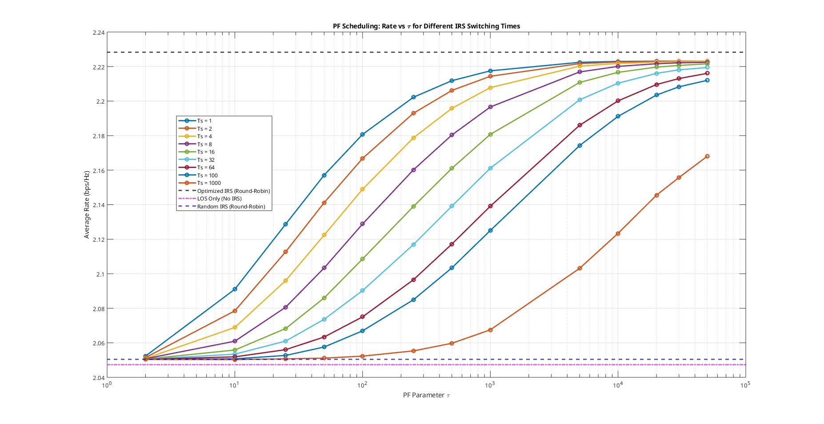
K = 50
N = 16

Slide 4
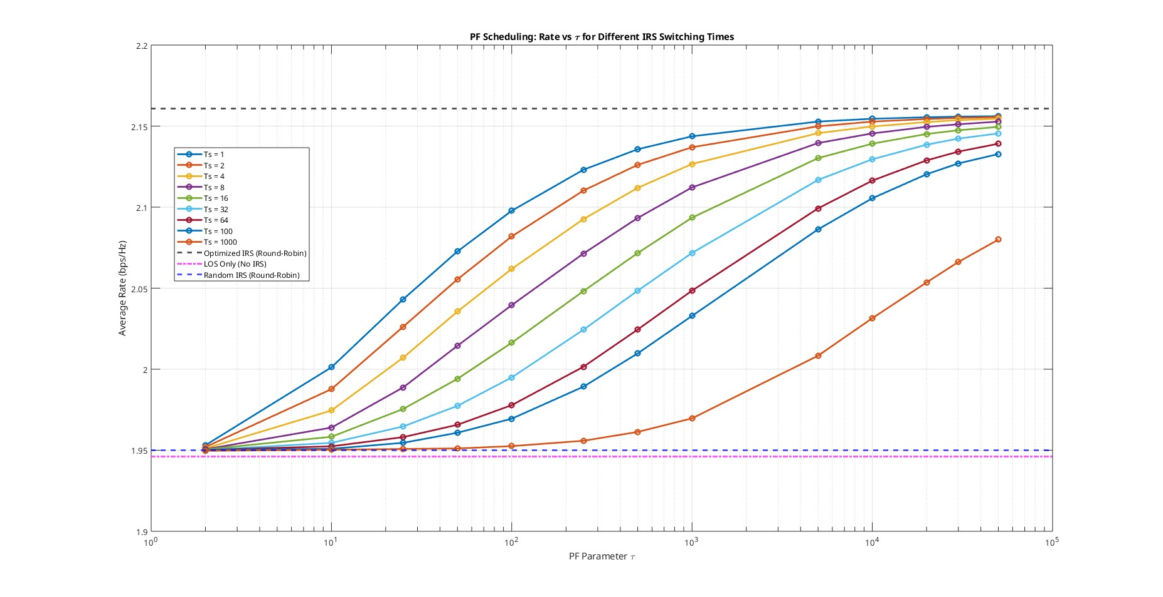
K = 25
N = 32

Slide 5
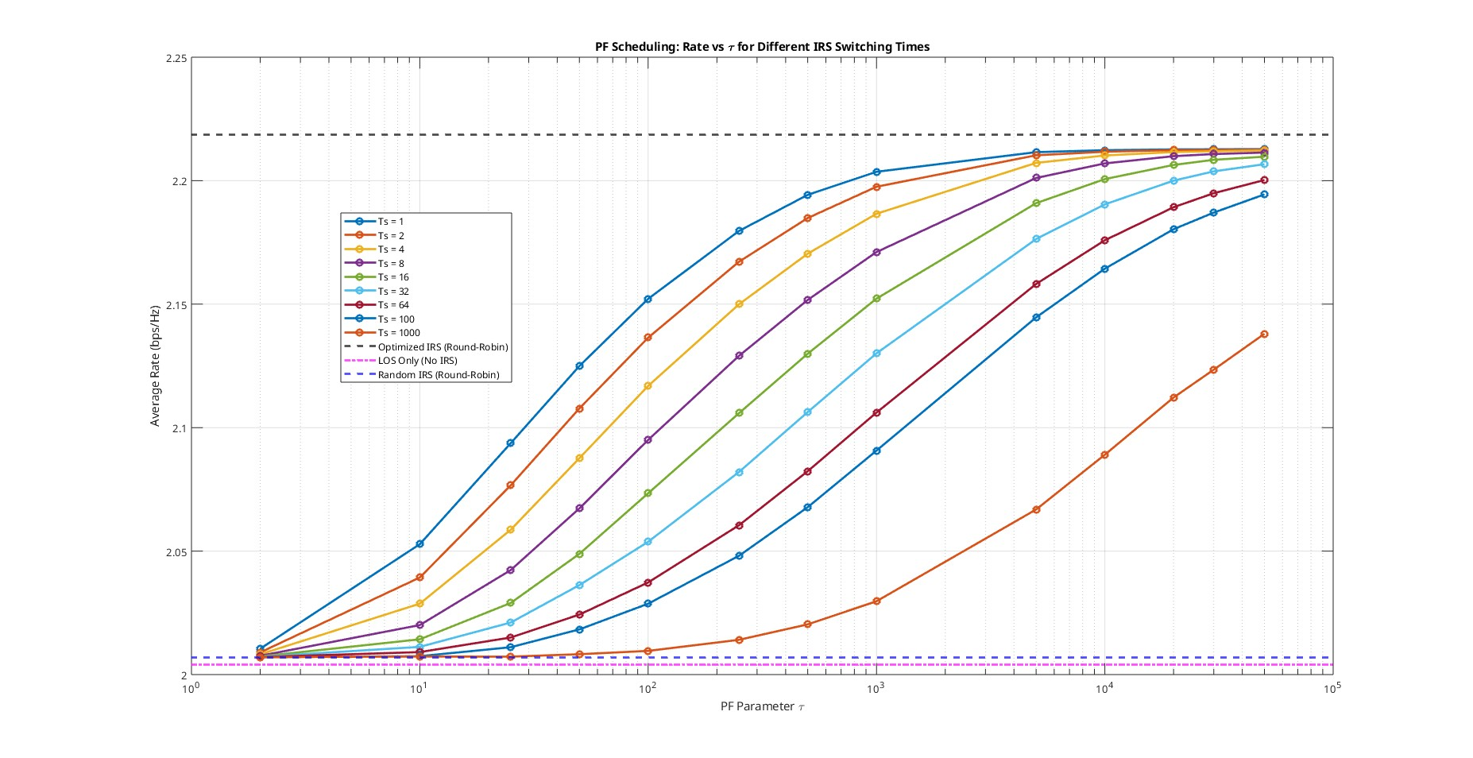
K = 50
N = 32

Slide 6


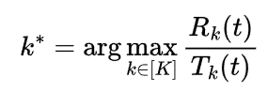
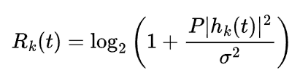
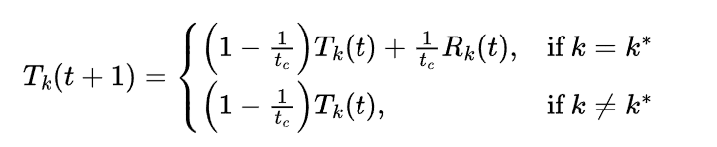
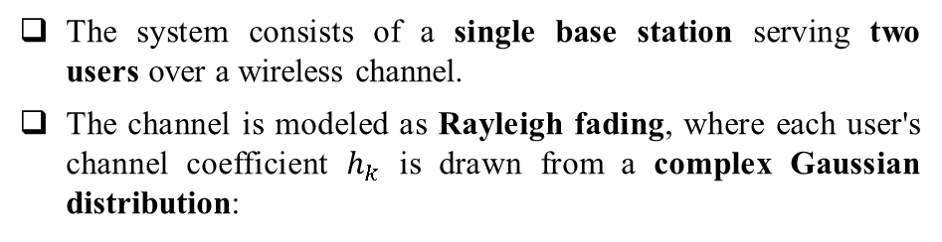

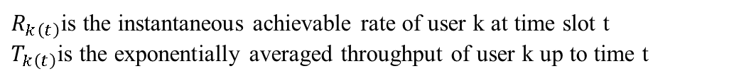

System Model Overview
The system consists of a single base station serving two users over a wireless channel.
The channel is modeled as Rayleigh fading, where each user's channel coefficient $h_{k}$​ is drawn from a complex Gaussian distribution:
$h_{k}∼CN\left(0, σ_{k}^{2}\right)$
where $σ_{k}^{2}$​ depends on the user's current SNR.
Scheduling Algorithm
  The base station uses Proportional Fair (PF) scheduling to select the user
The PF scheduler selects the user $k^{∗}$
BS
User-1
User-2
$R_{k\left(t\right)}$is the instantaneous achievable rate of user k at time slot t
$T_{k\left(t\right)}$is the exponentially averaged throughput of user k up to time t
The throughput is updated as:
Where $t_{c}$ is the averaging window parameter.

